Slide 1


Display
By: Dalia Ihab

Slide 2


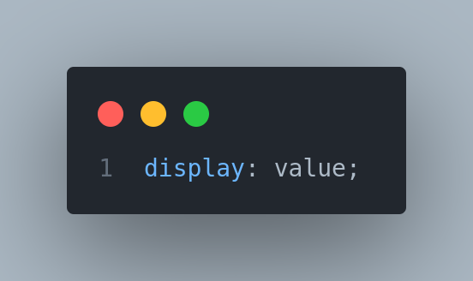
Display
The Display property in CSS defines how the components(div, hyperlink, heading, etc) are going to be placed on the web page. As the name suggests, this property is used to define the display of the different parts of a web page.

Slide 3
visibility: hidden;

Slide 4
Positioning
By: Dalia Ihab

Slide 5
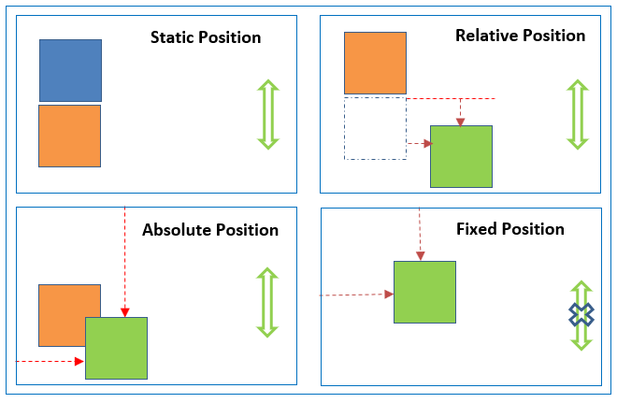
Positioning
Notes:
https://www.csssolid.com/css-position.html

Slide 6


Next
CSS Floats

